Slide 1
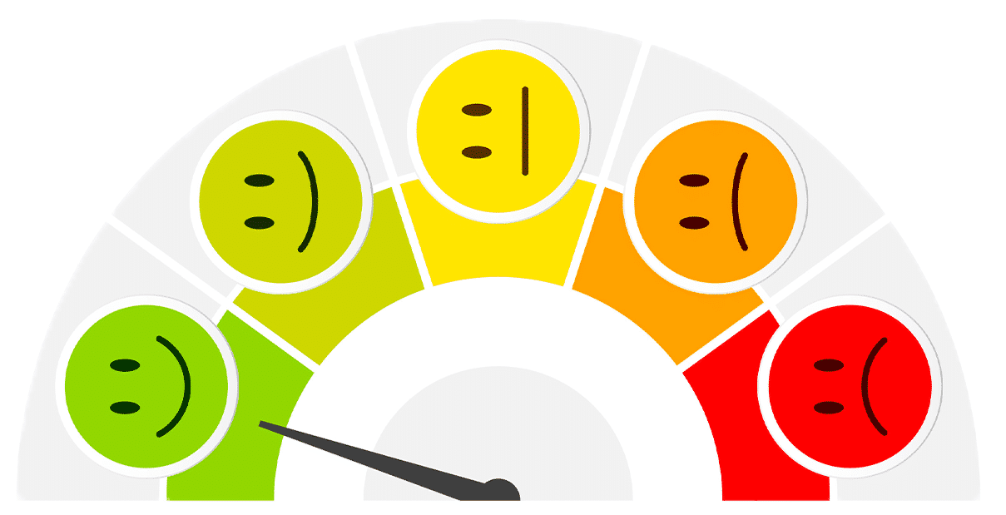
TWITTER SENTIMENT ANALYSIS:
AI IN EDUCATION
By: Jada Ogueh

Slide 2
TABLE OF CONTENTS
01
02
03
RATIONALE
Introducing the need, problem, and solution
STEPS
Explaining data gathering, pre-processing, analyzation, and visualization
RESULTS
Summary and Conclusion

Slide 3
RATIONALE
01.

Slide 4

NEED
Artificial intelligence has become very popular in the past year. Tools like ChatGPT have allowed students to bypass schoolwork, get easy answers, but also deepen their understanding of concepts their schooling may not properly address. There are a number of ways to use A.I. and the school system is divided on how to address this new technology…

Slide 5
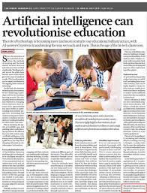



Slide 6
How can we gauge public opinion on AI in education to help guide school policies?

Slide 8
SOLUTION
Create sentiment visualizations based on tweets to show public opinion on A.I. in education. Based on the general opinion, we can give policymakers a better idea on how to handle A.I. integration in schooling. I will use the pandas library in Python to analyze a database full of tweets regarding AI in education.

Slide 9

STEPS
O2.

Slide 10
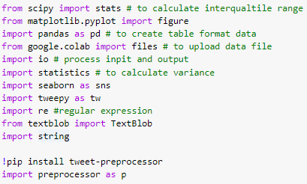
GATHERING THE DATA (1)
01
Import the important libraries as these will allow us to conduct data processing and visualization.

Slide 11
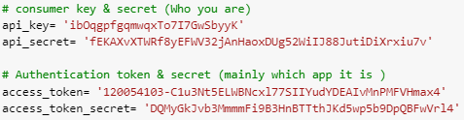
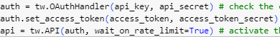
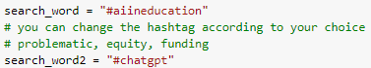
GATHERING THE DATA (2)
02
Set up Twitter API keys and secrets (who I am) and authentication token and secret (the app it is).
03
Activate the Twitter API.
04
Set up my two search queries: #aiineducation and #chatgpt

Slide 12
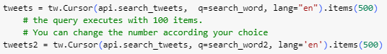
GATHERING THE DATA (3)
05
Request 500 tweets each containing my desired hashtags.
06
Initialize a Pandas DataFrame using the data from each query.
07
Combine the two dataframes into one dataframe, and now I’ve collected my data.

Slide 13
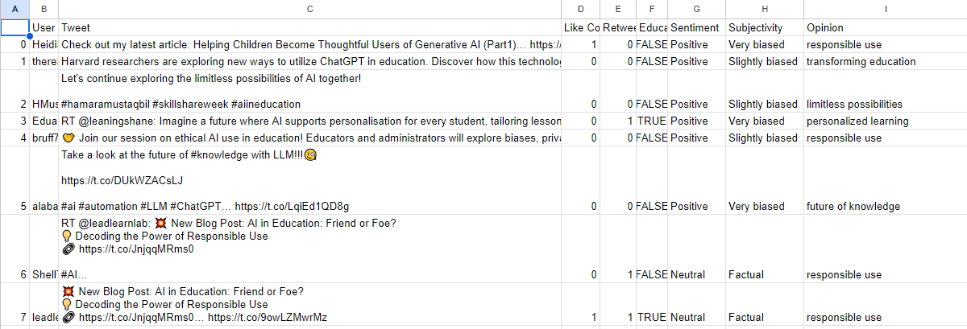
EXAMPLES OF MY DATA

Slide 14
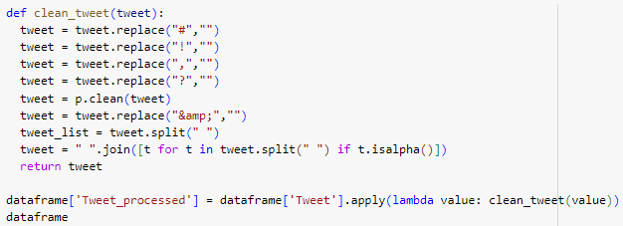
PRE-PROCESSING THE DATA (1)
Delete duplicate tweets and clean up the tweets by removing RT, mentions, and non-alphabetical characters from the tweets

Slide 15
PRE-PROCESSING THE DATA (1)
Delete duplicate tweets and clean up the tweets by removing RT, mentions, and non-alphabetical characters from the tweets
No need: Tweet_processed produced identical results in sentiment analysis to Tweet.

Slide 16
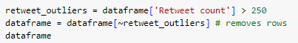
PRE-PROCESSING THE DATA (2)
Removing tweets with a massive amount of retweets as it skews the data.

Slide 17
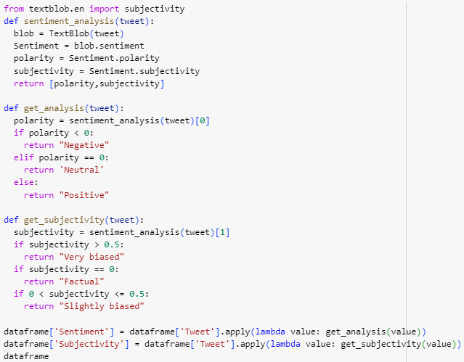
ANALYZING THE DATA (1)
I used the Text Blob library to conduct sentiment and subjectivity analysis on the Tweet column, and saved the results to 2 new columns:
Sentiment
Positive
Negative
Neutral
Subjectivity
Very biased
Slightly biased
Factual
01

Slide 18
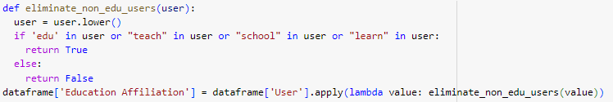
ANALYZING THE DATA (2)
02
I wanted to track the difference in opinions between users that were affiliated with education versus not, so I created a column called Education Affiliation that was True if the username contained keywords related to education such as teach or edu.

Slide 19
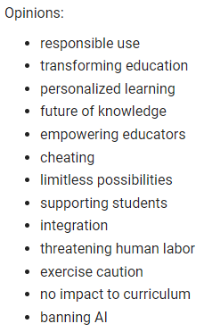
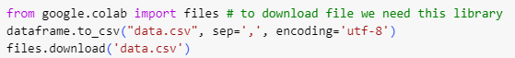
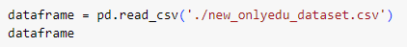
ANALYZING THE DATA (3)
03
I had to download my dataframe as a CSV so I could manually check the validity of my sentiment and subjectivity column, but also add the Opinion column which stated the opinion expressed in a tweet. Afterwards I loaded that CSV into another dataframe.

Slide 21
RESULTS - VISUALIZATION
O3.

Slide 22
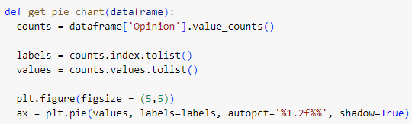
PIE CHART

Slide 23
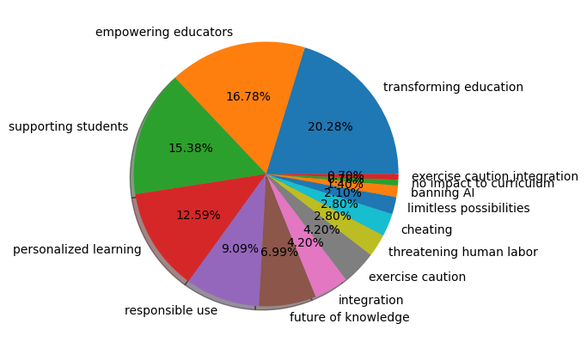
ALL
Figure 1: Opinion breakdown amongst all tweets

Slide 24
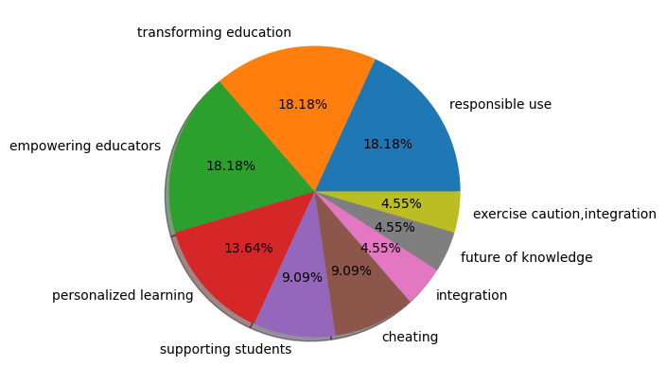
EDUCATION USERS
Figure 2: Opinion breakdown amongst tweets from users with usernames pertaining to education

Slide 25
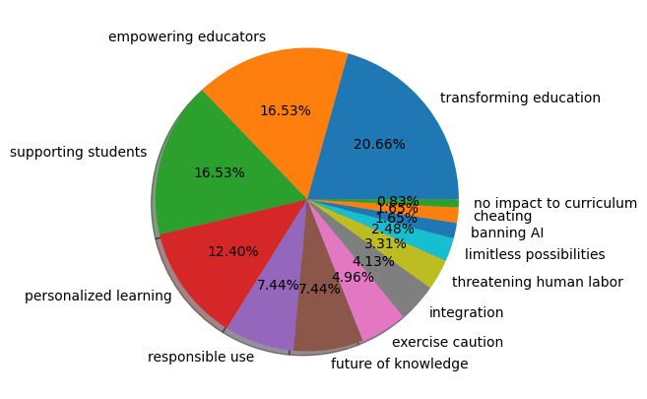
NON EDUCATION USERS
Figure 3: Opinion breakdown amongst tweets from users with usernames not pertaining to education

Slide 26
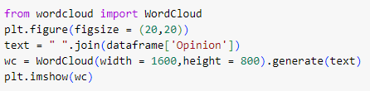
WORD CLOUD

Slide 27
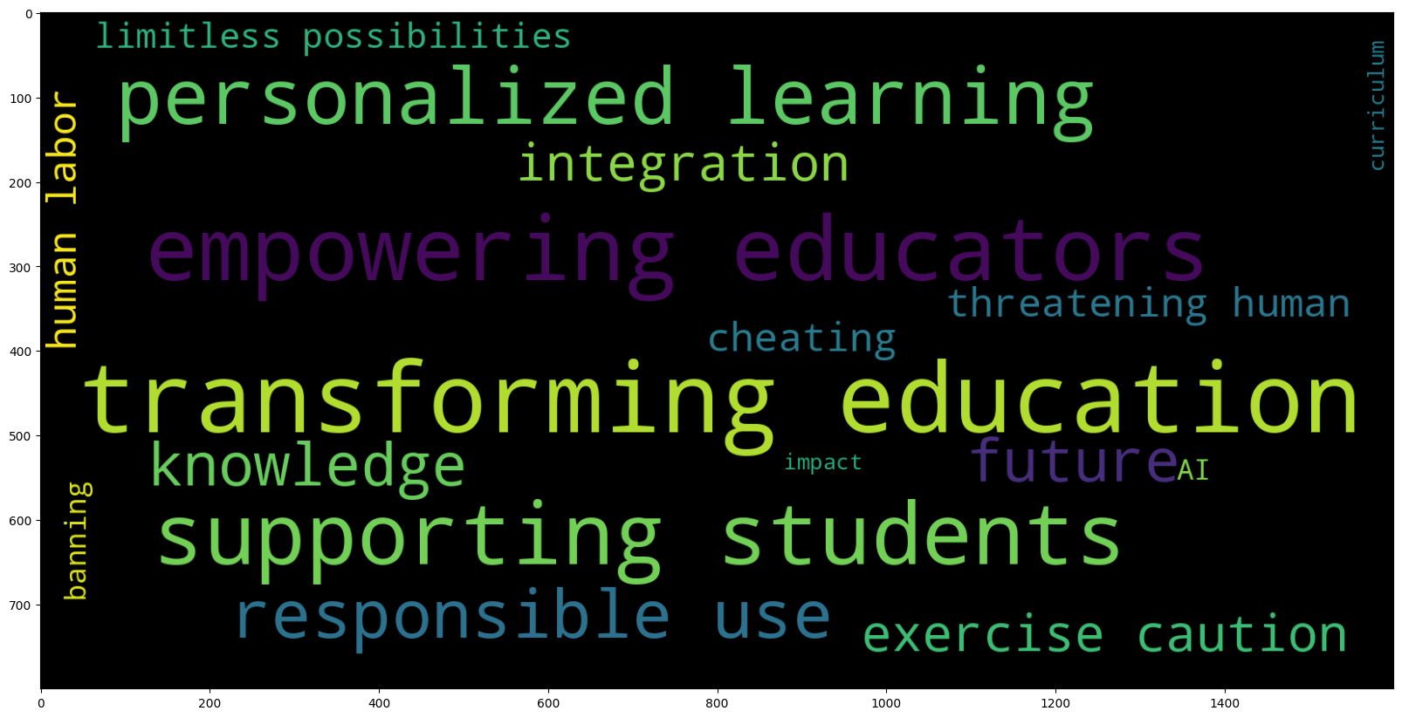
Figure 4: Opinion breakdown amongst all tweets

Slide 28
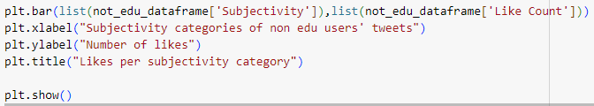
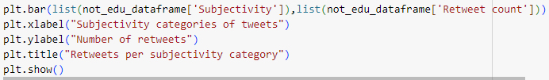
BAR GRAPHS (1)

Slide 29
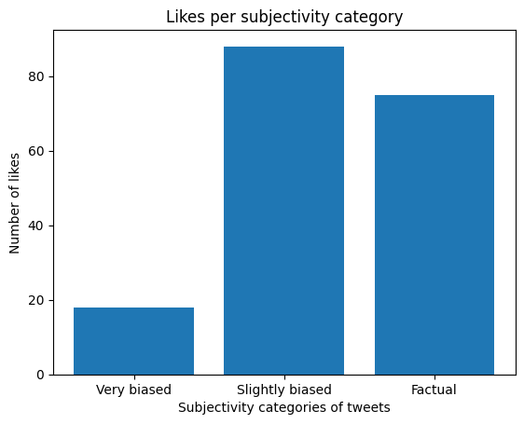
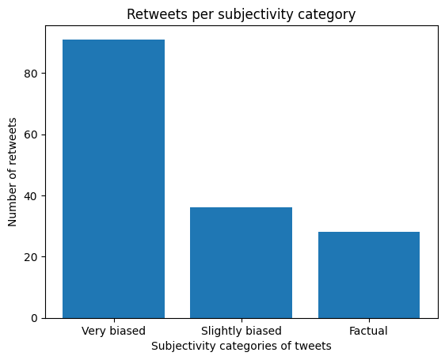
ALL: BIAS VS LIKES/RETWEETS
Figure 5: The number of likes tweets with a subjectivity category received
Figure 6: The number of retweets tweets with a subjectivity category received

Slide 30
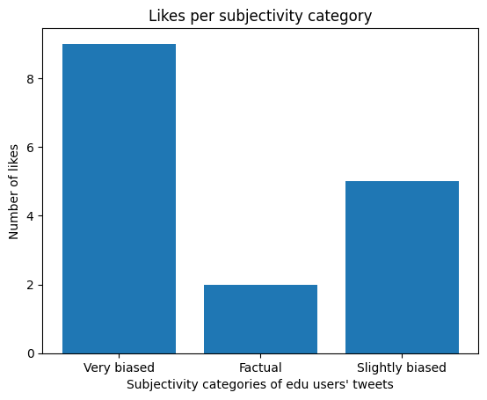
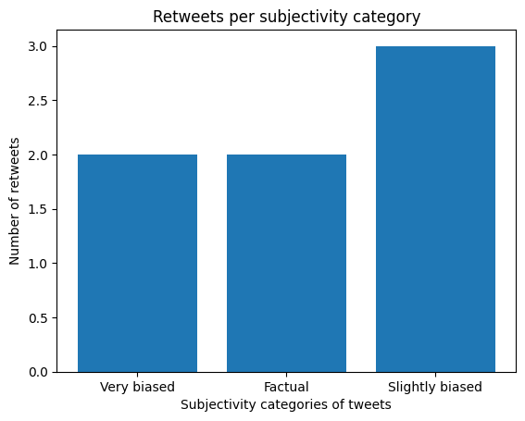
EDU: BIAS VS LIKES/RETWEETS
Figure 7: The number of likes tweets with a subjectivity category received from users affiliated with education
Figure 8: The number of retweets tweets with a subjectivity category received from users affiliated with education

Slide 31

NON EDU: BIAS VS LIKES/RETWEETS
Figure 9: The number of likes tweets with a subjectivity category received from users not affiliated with education
Figure 10: The number of likes tweets with a subjectivity category received from users not affiliated with education

Slide 32
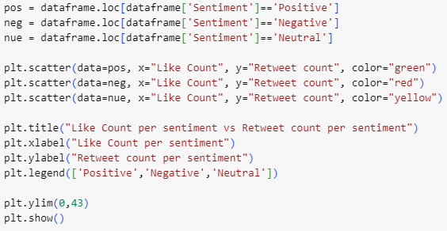
SENTIMENT ANALYSIS VS RETWEETS

Slide 33
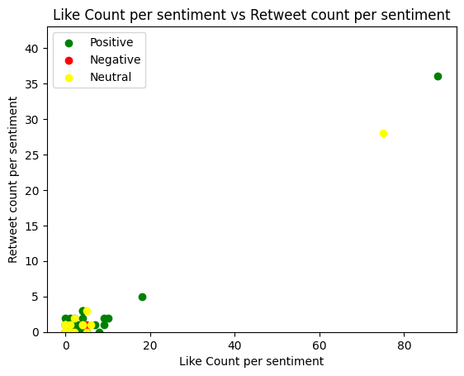
Figure 11: Like count and retweet count for tweets associated with a subjectivity category

Slide 34
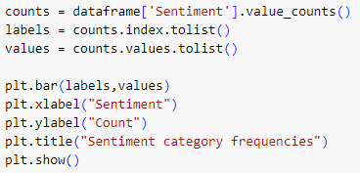
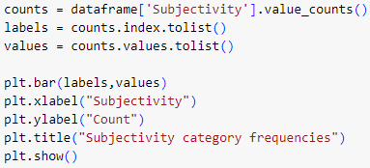
BAR GRAPHS (2) - SENTIMENT AND SUBJECTIVITY

Slide 35
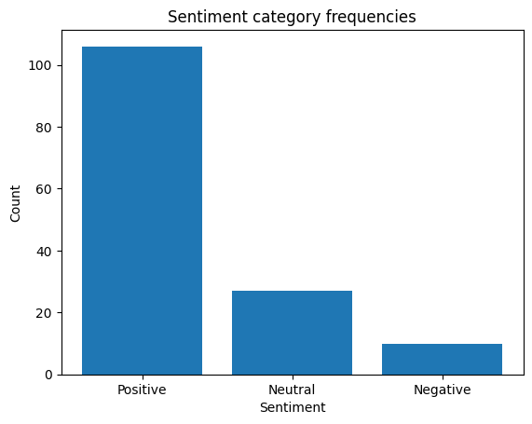
Figure 12: The number of tweets belonging to each sentiment category

Slide 36
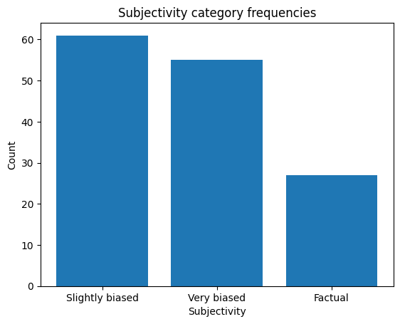
Figure 13: The number of tweets belonging to each subjectivity category

Slide 37

RESULTS - CONCLUSION
O3.

Slide 38
SUMMARY
In general, the public has positive (and slightly biased) opinions on AI in education, believing it can be used to enrich education by empowering educators, supporting students, and transforming the way we learn.
Although a prominent neutral take is that we must use AI responsibly, it doesn’t protest against the use of AI.
Surprisingly, strong ideas like banning AI and the fear of cheating were hardly mentioned.
This sentiment analysis project helps to provide reasons to politicians and school administration for why we should embrace integrating AI in education and not try suppressing it. It demonstrates how people would use AI in a good way, not just malicious ways.
My next steps would be to try and analyze data from other Twitter hashtags and branch out to other social media platforms such as Instagram, Facebook, and TikTok.

Slide 39
TAKEAWAYS
I learned how to use data mining to create my own datasets. I am very used to working with data already processed and cleaned, and this revealed how I can gain deeper insights being able to process the data myself.

Slide 40
THANK YOU!

